Slide 1

Database of shape models suitable for the description of meteoroids and small monolithic asteroids
https://shapemodels.asu.cas.cz
D. Čapek¹, J. Haloda², T. Henych¹, J. Kaiser³, P. Koten¹, R. Macke⁴, J. Pachman⁵, M. Petřík³, M. Schimmerohn⁶, Z. Štubianová³, E. Watson ⁶, and Tomáš Zikmund³
¹ Astronomical Institute ASCR, Ondřejov, Czechia (david.capek@asu.cas.cz)
² Czech Geological Survey, Praha, Czechia
³ CEITEC Brno University of Technology, Brno, Czechia
⁴ Vatican Observatory, Vatican City
⁵ University of Pardubice, Pardubice, Czechia
⁶ Fraunhofer institute for High-Speed Dynamics, EMI, Freiburg, Germany

Slide 2
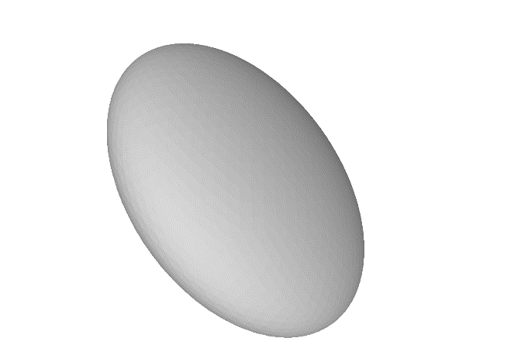
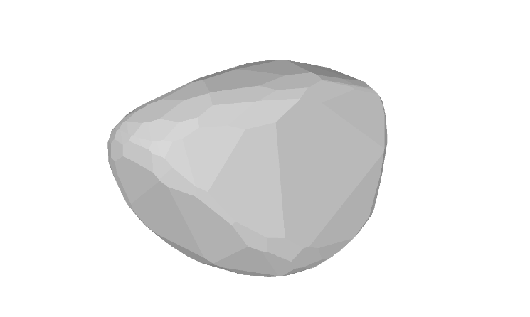
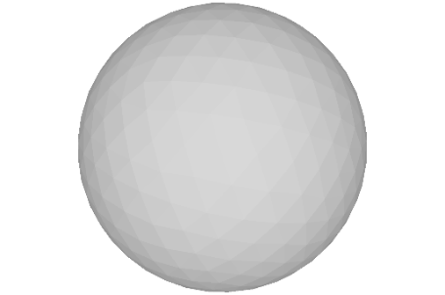
Motivation
Rotation of meteoroids in space – unknown (almost)
Important action of non-gravitational effects
Very sensitive to shape of the body
Insuficient:
sphere
ellipsoid
2000 LU36
(lc inversion)

Slide 3
Meteoroids and small monolithic asteroids… how to determine their shapes?
Too small to be directly observed as moving independently in space (exceptions!).
Blocks on the surface of asteroids (Itokawa: Michikami et al., 2010, Icarus 207, Fig. )
Material from sample return missions
Hypervelocity fragmentation experiments

Slide 4
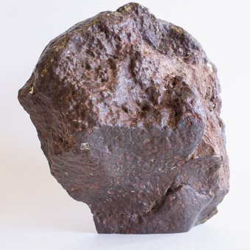
Method of creation the shape models

Slide 5
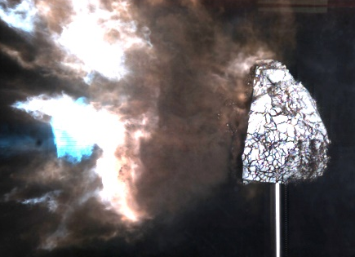
Method of creation the shape models

Slide 6
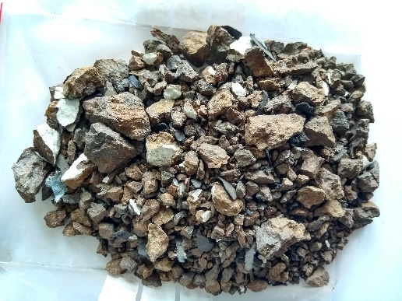
Method of creation the shape models

Slide 7
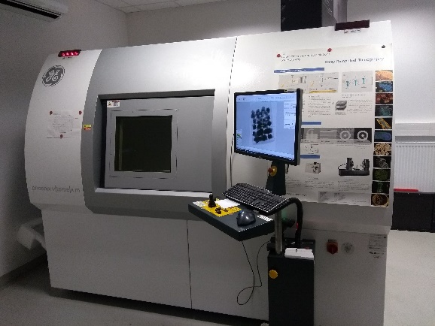
Method of creation the shape models

Slide 8
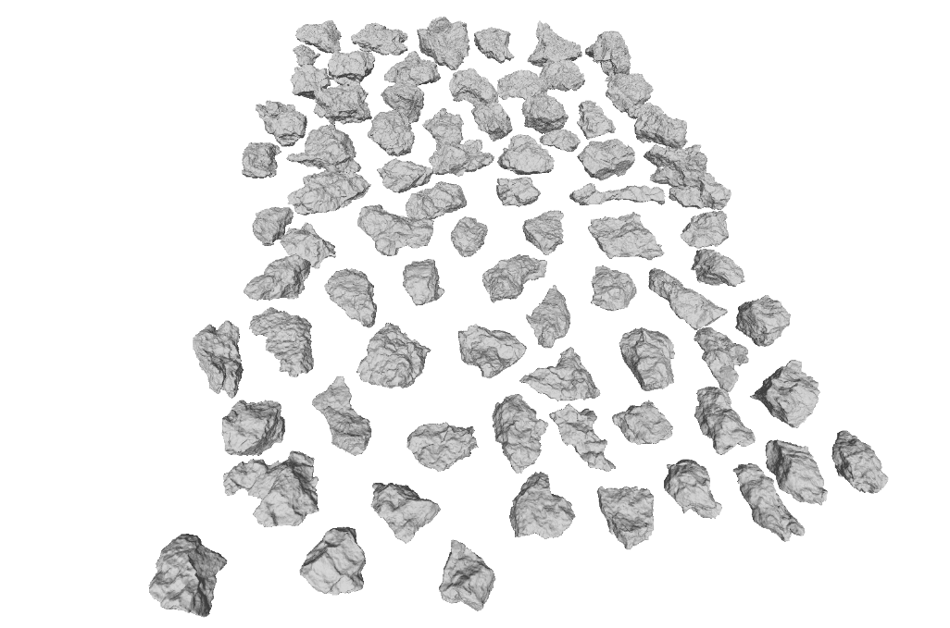
Method of creation the shape models

Slide 9
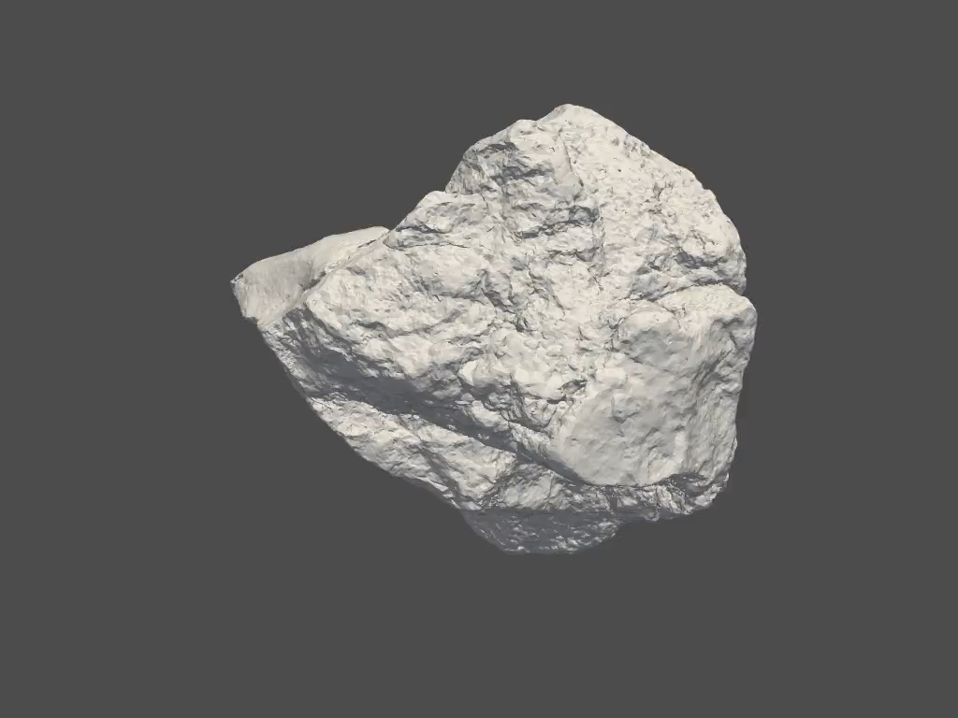
Samples
L3-6 ordinary chondrite NWA 869
L01 – 853 g
L02 – 947 g
Terrestrial rock – tephriphonolite
T01 – 834g

Slide 10
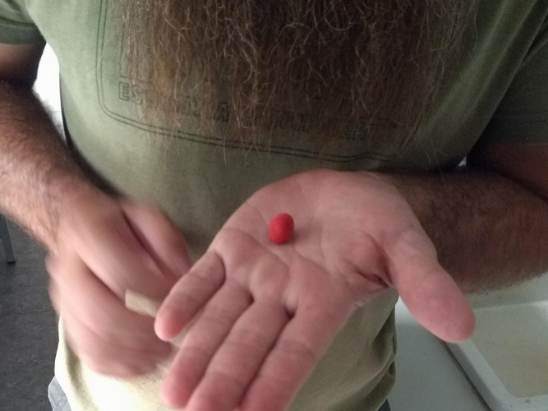
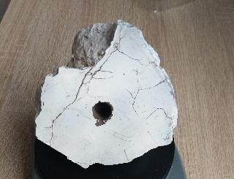
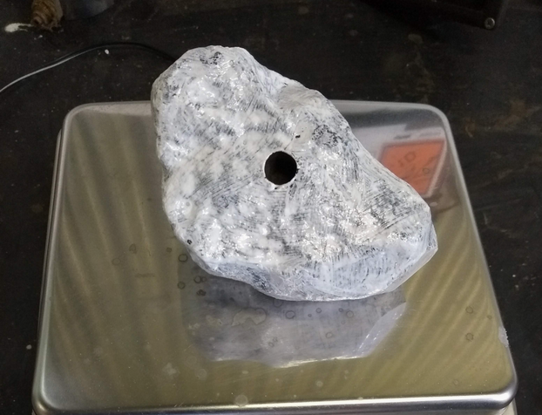
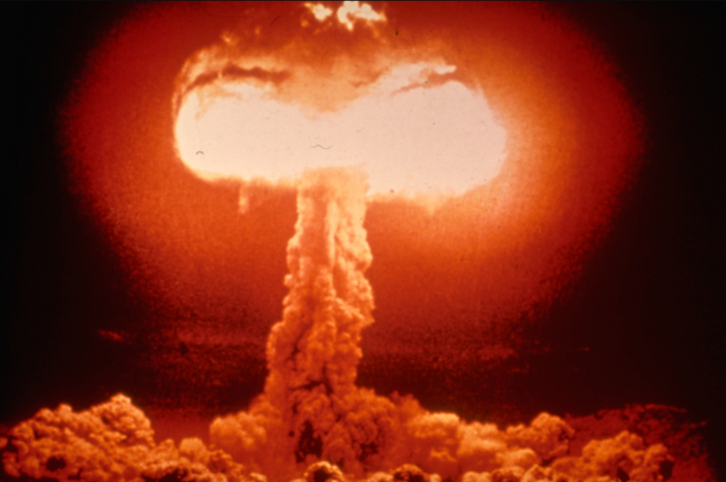
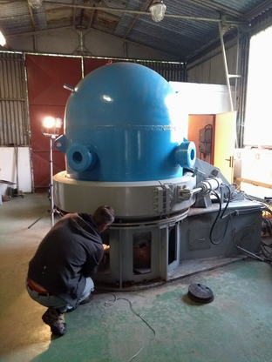
Contact charge technique
Semtex 1A
Drilled hole in the sample
shot
Contact charge technique | Target mass (g) | Explosive mass (g) | Specific energy (kJ/kg)
NWA 869, L02 | 947 | 2.11 | 13.4
Tephriphonolite T01 | 834 | 1.25 | 9.0
Hypervelocity impact simulated by blasting the sample with a plastic explosive
Not much expensive… <150 EUR per shot

Slide 11
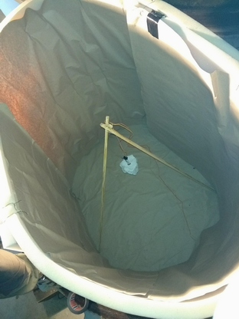
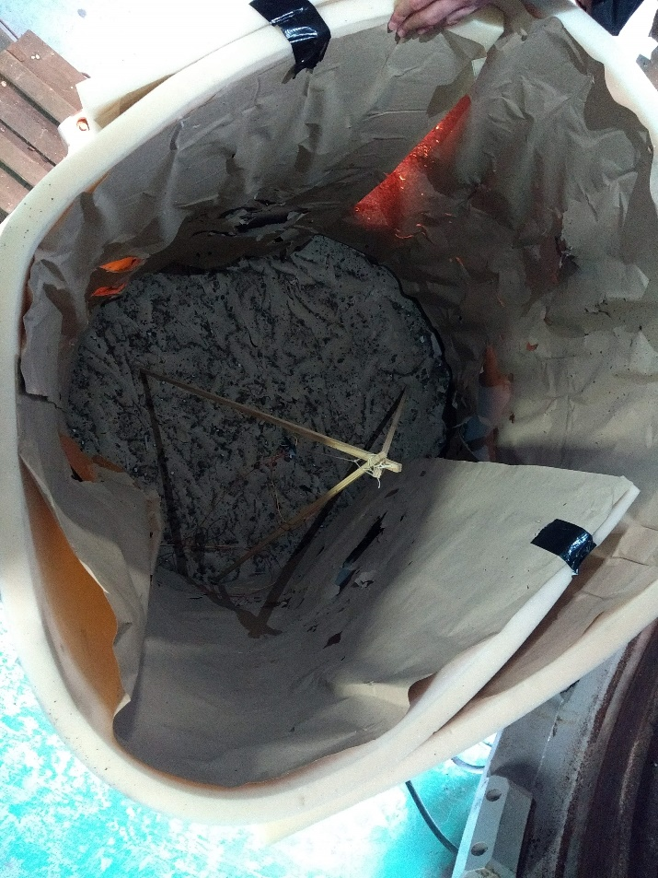
Contact charge technique
The chamber was covered by padding to prevent secondary fragmentations.

Slide 12
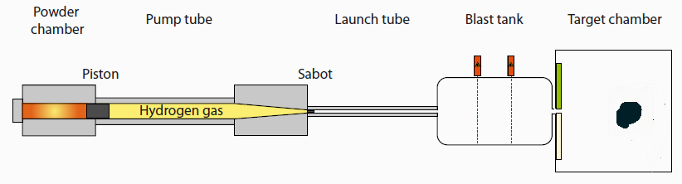
Impact of hypervelocity projectile
Poelchau et al. 2013, Meteoritics & Planetary Science 48, Fig.1, modified.
Two-stage light-gas gun (Fraunhoffer EMI, Freiburg)
  one shot ~ 3800 EUR
L01 target (853 g of NWA869)

Slide 13
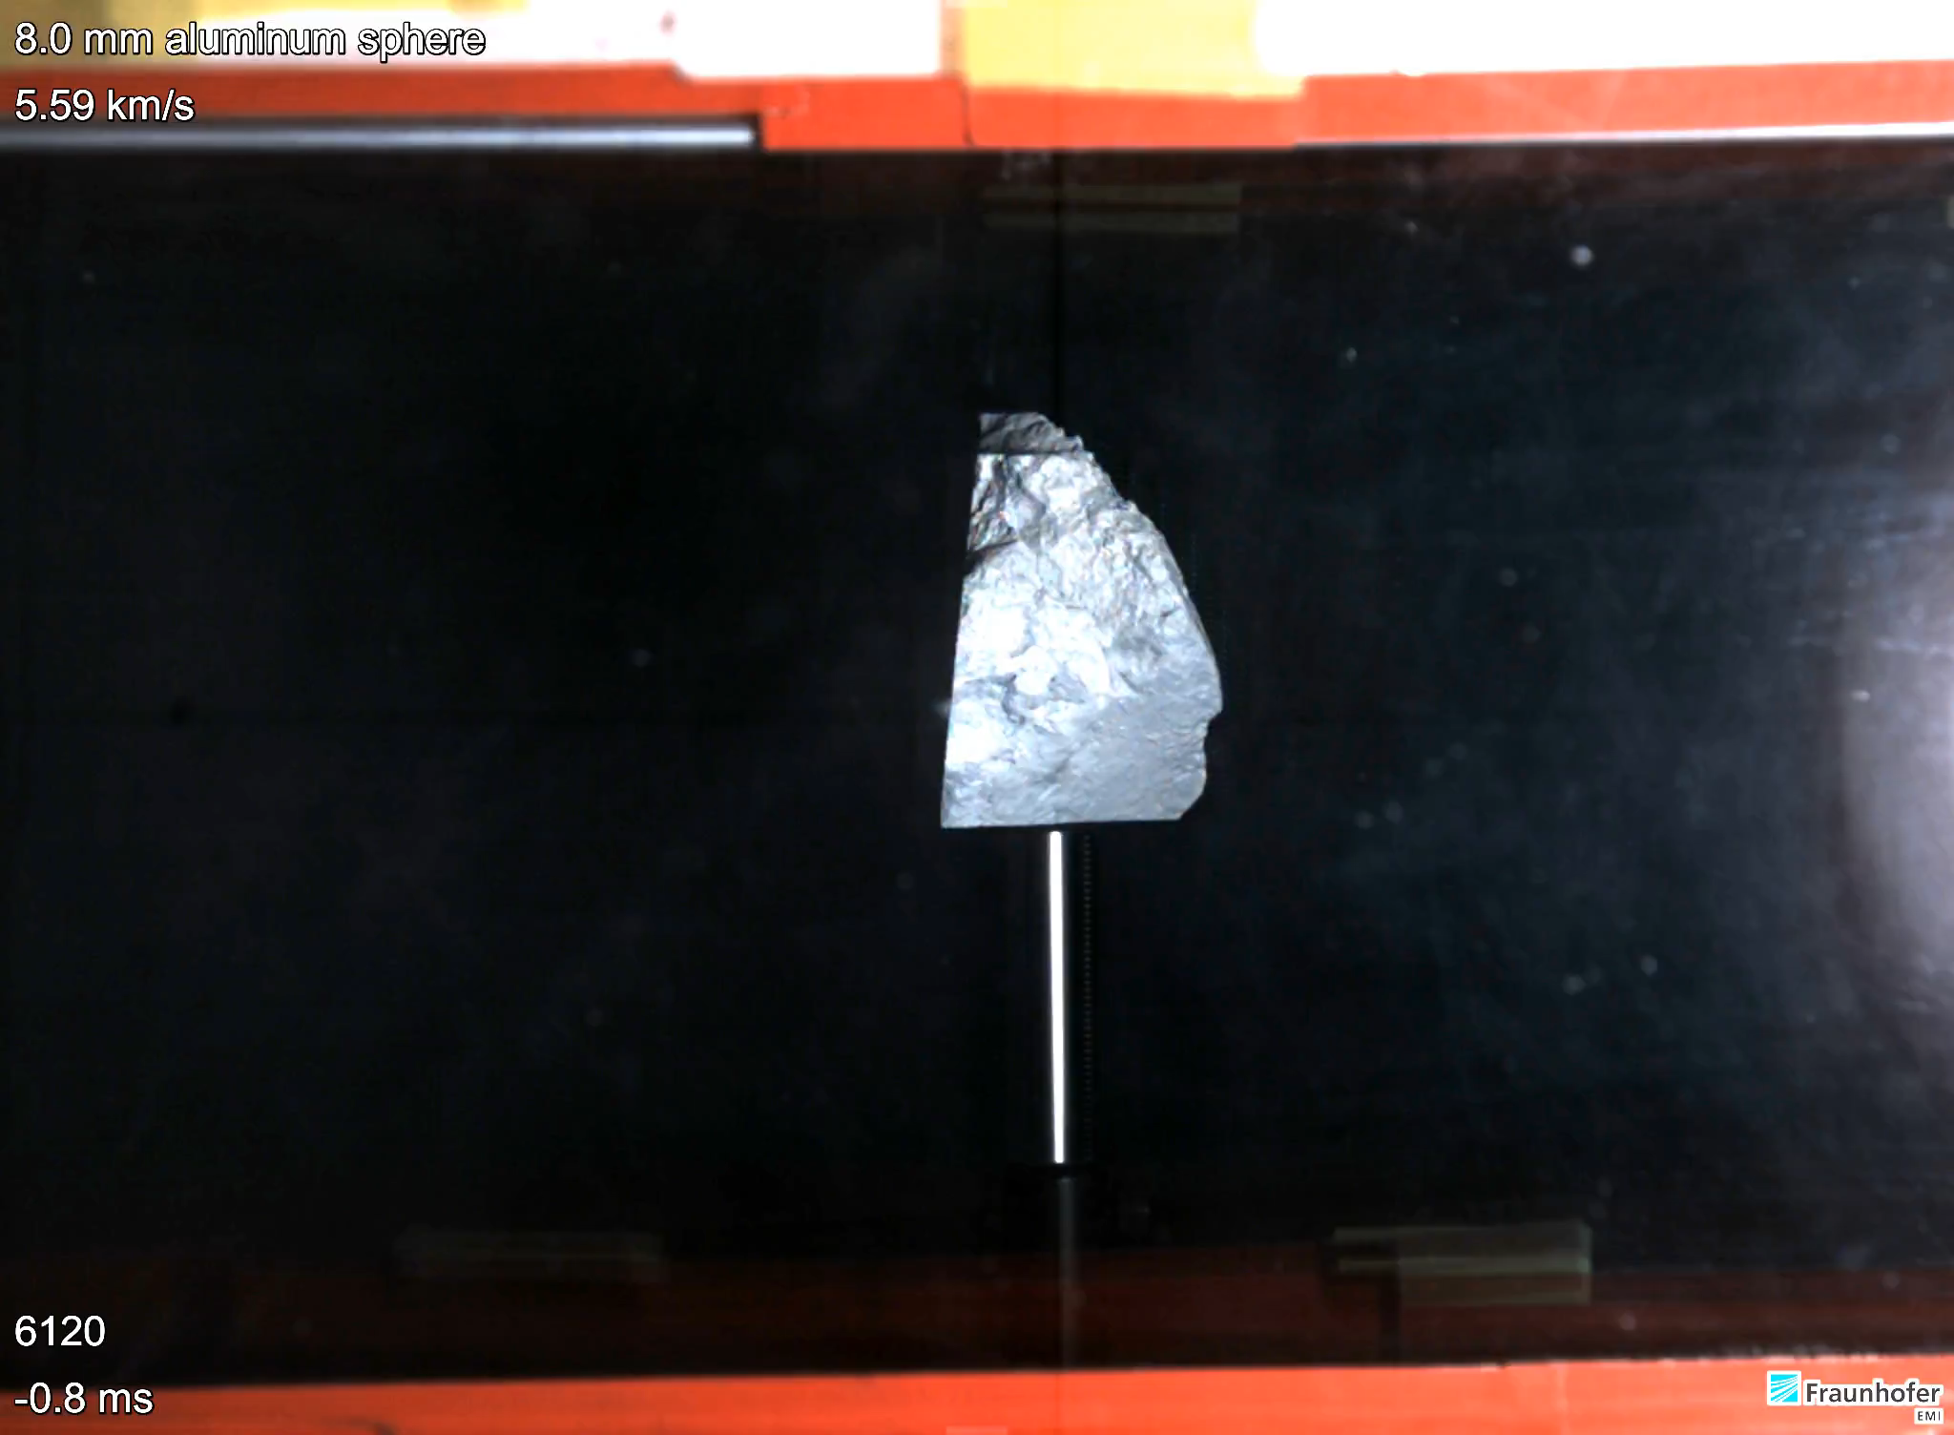
Hypervelocity impact fragmentation

Slide 14
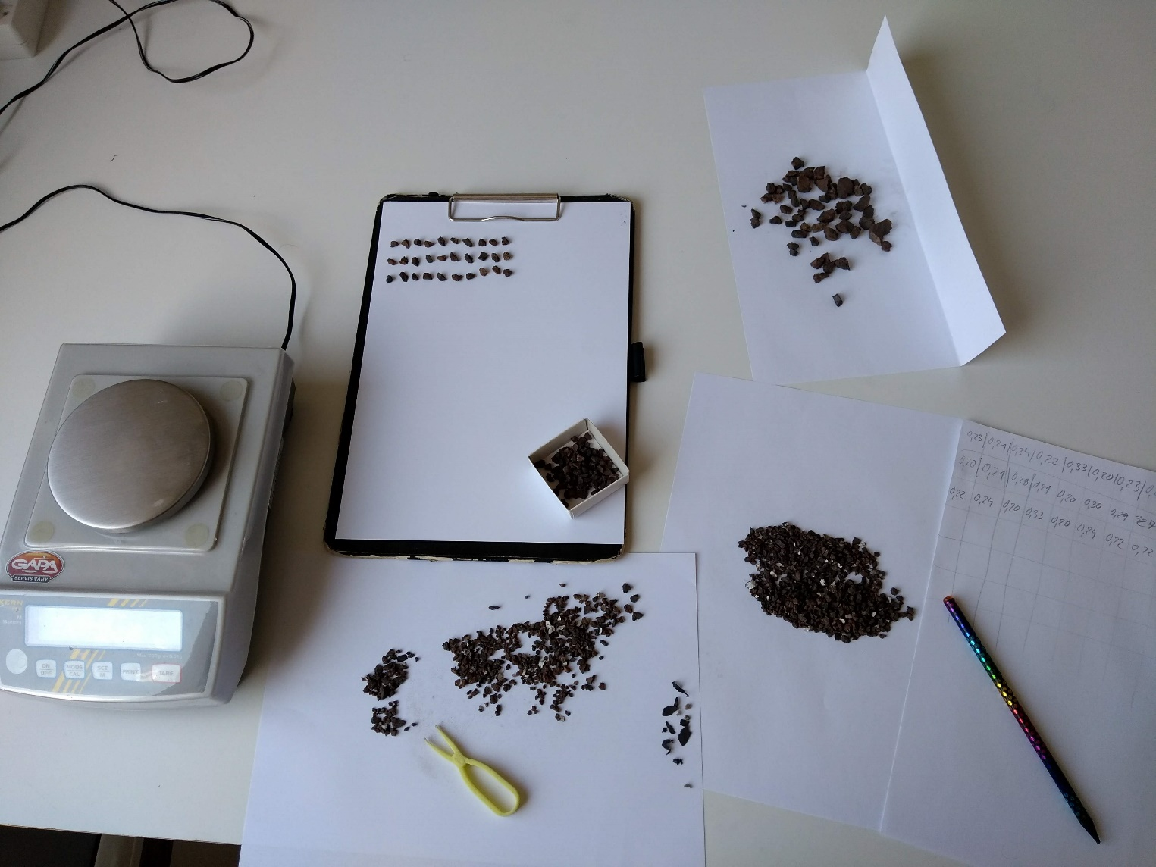

Selection of fragments
mass $≥$ 0.2 g
no white color

Slide 15
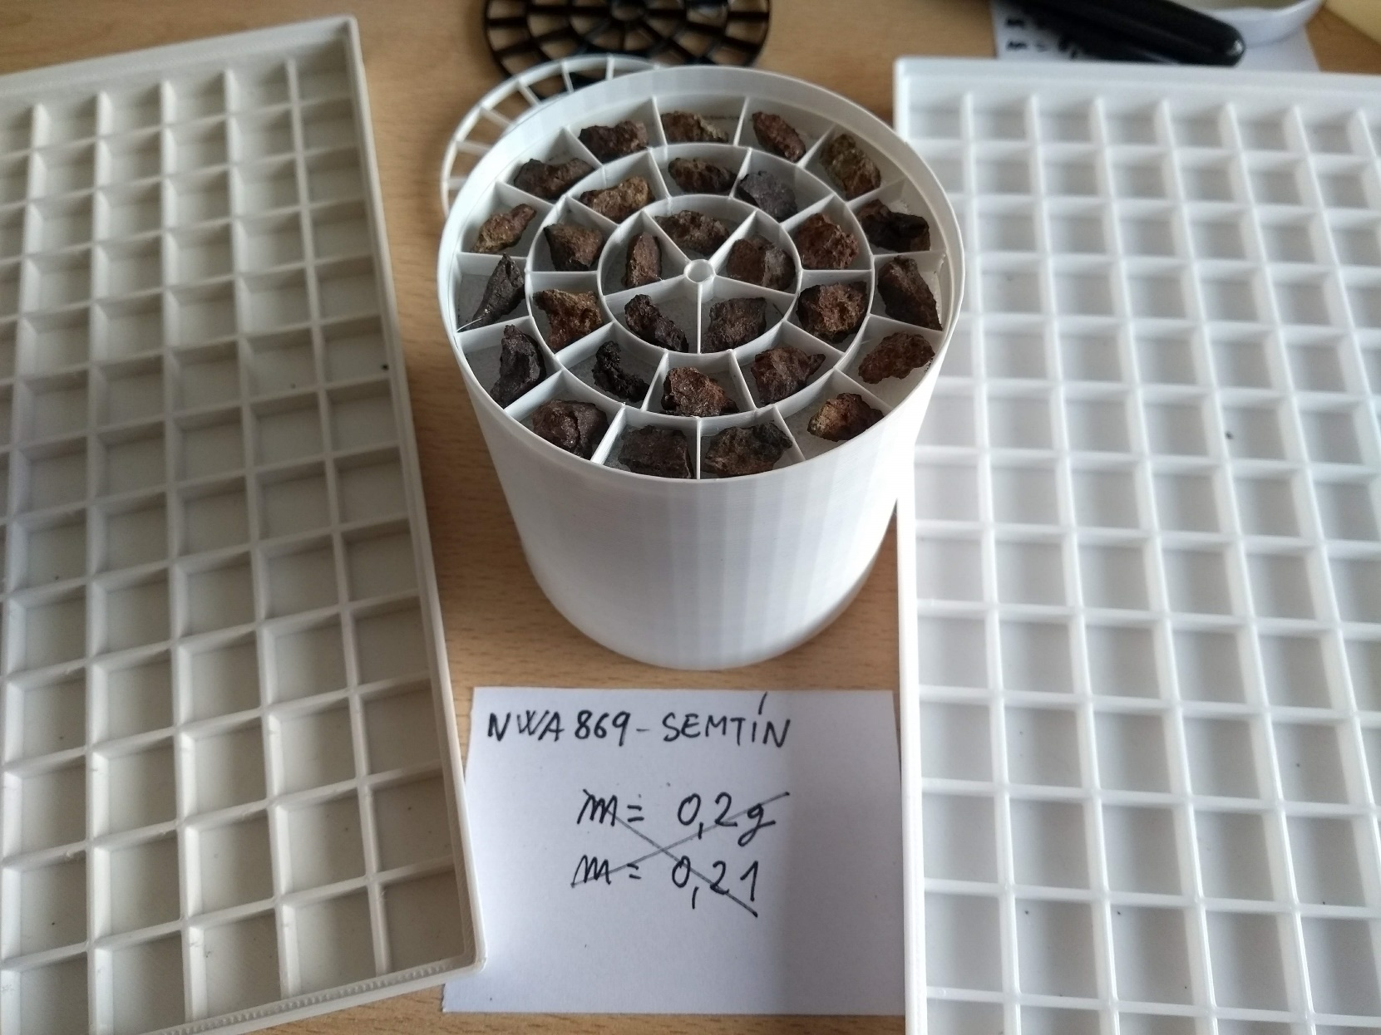
Selection of fragments

Slide 16
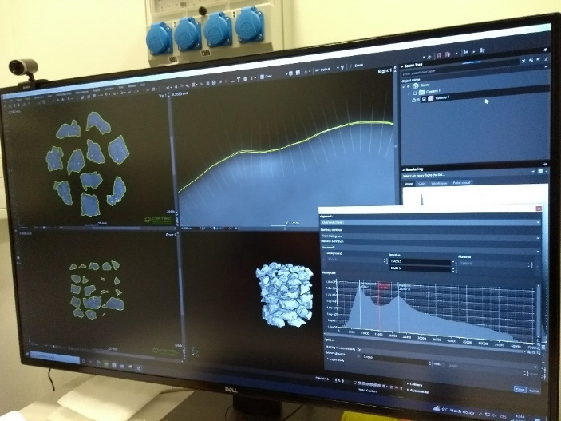
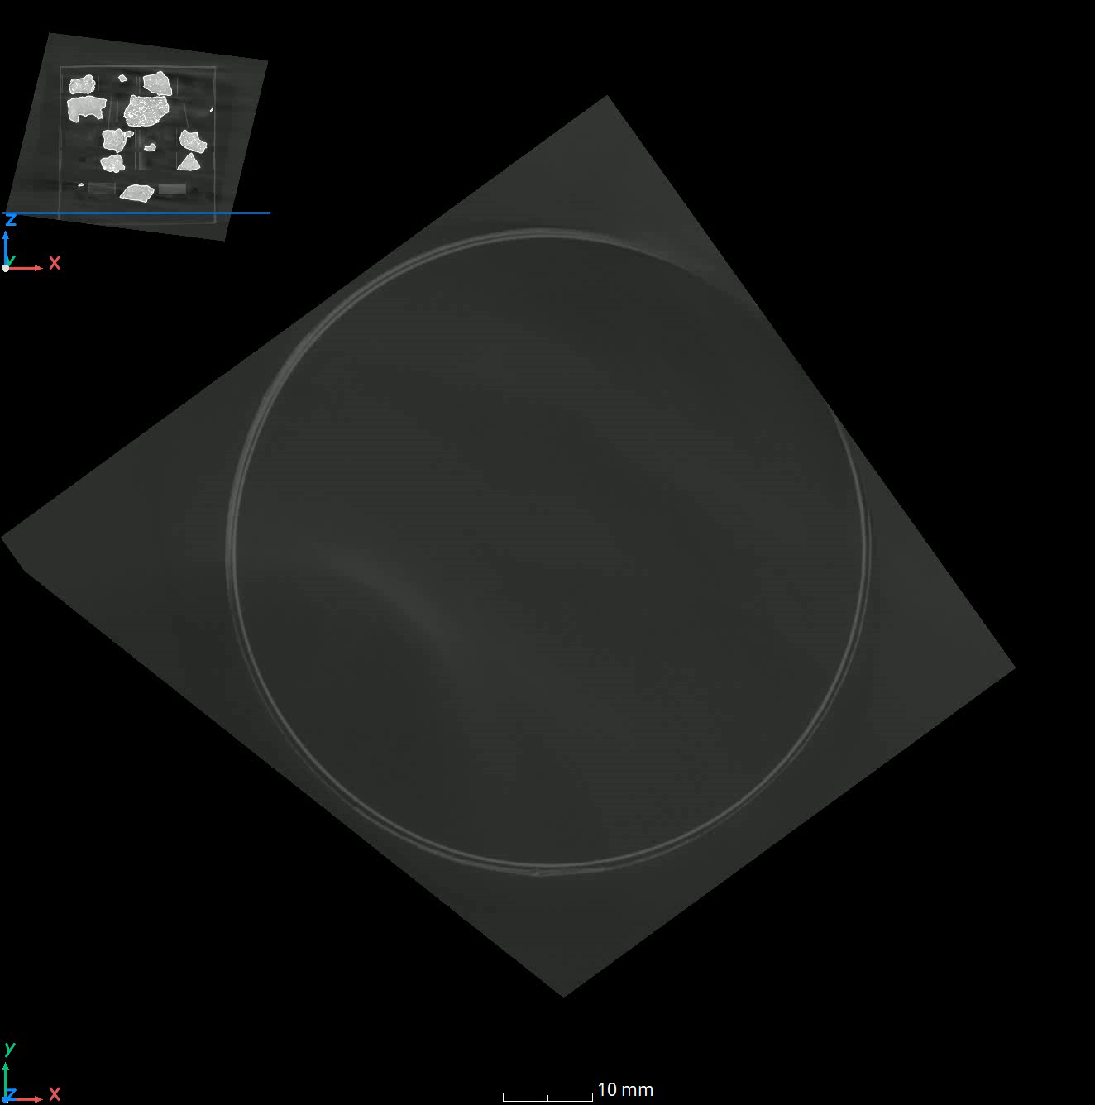
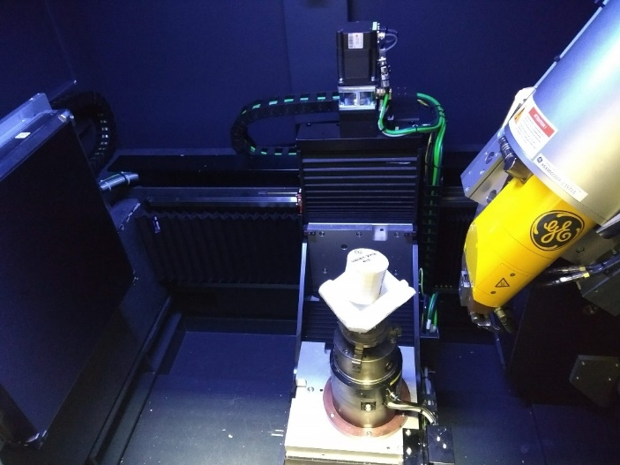
Digitization by X-ray CT
Laboratory of X-ray micro and nano CT, CEITEC Brno
Voxel size 45/55 µm

Slide 17
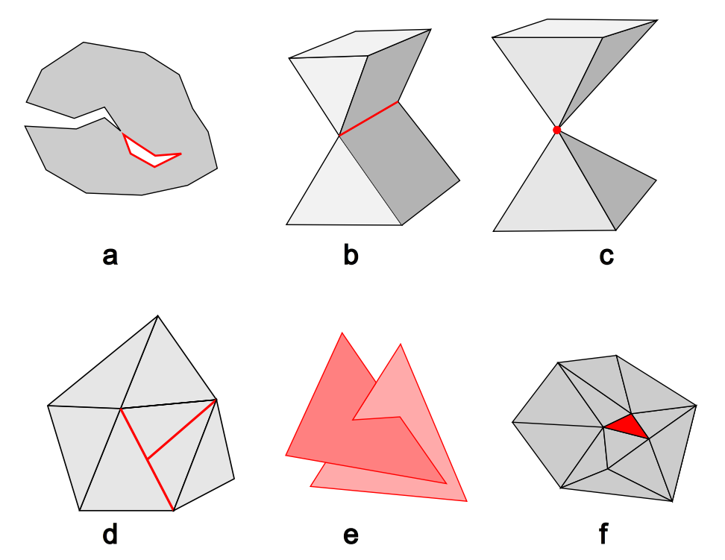
Postprocessing – topological defects
separate parts non-2-manifold edge non-2-manifold vertice
T-vertice self-intersecting faces holes

Slide 18
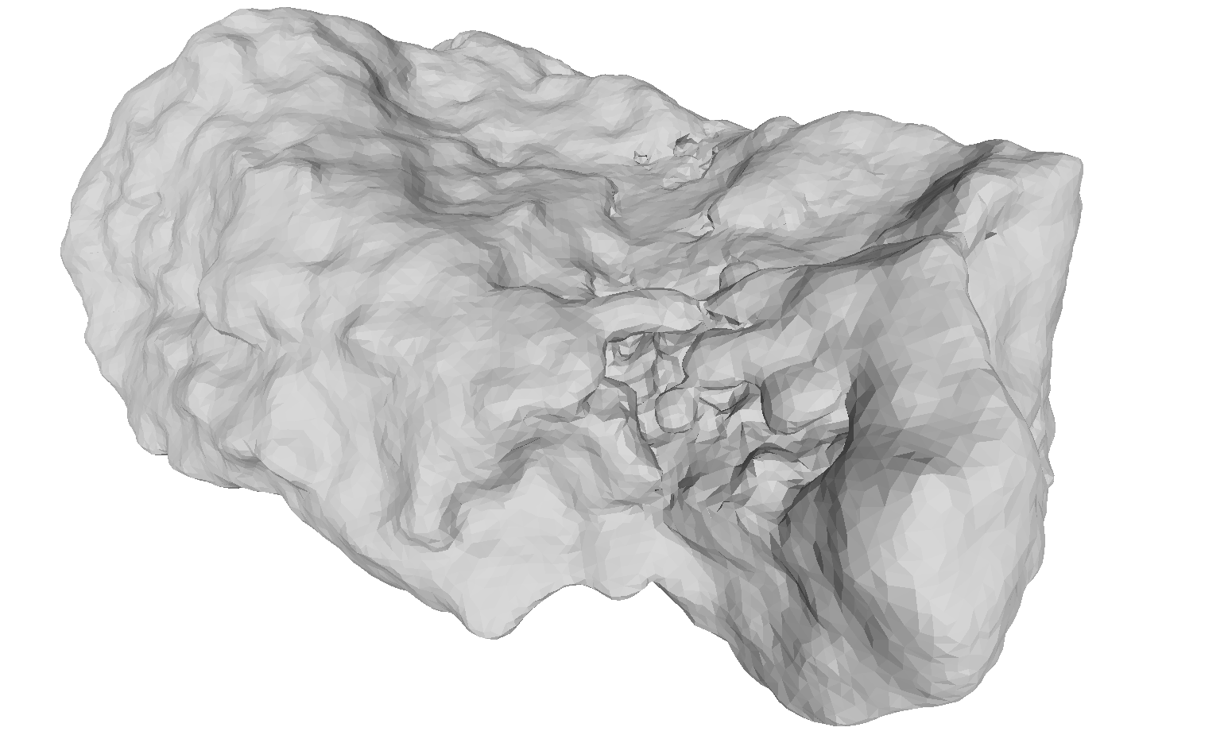
Postprocessing - artefacts
47 cases

Slide 19
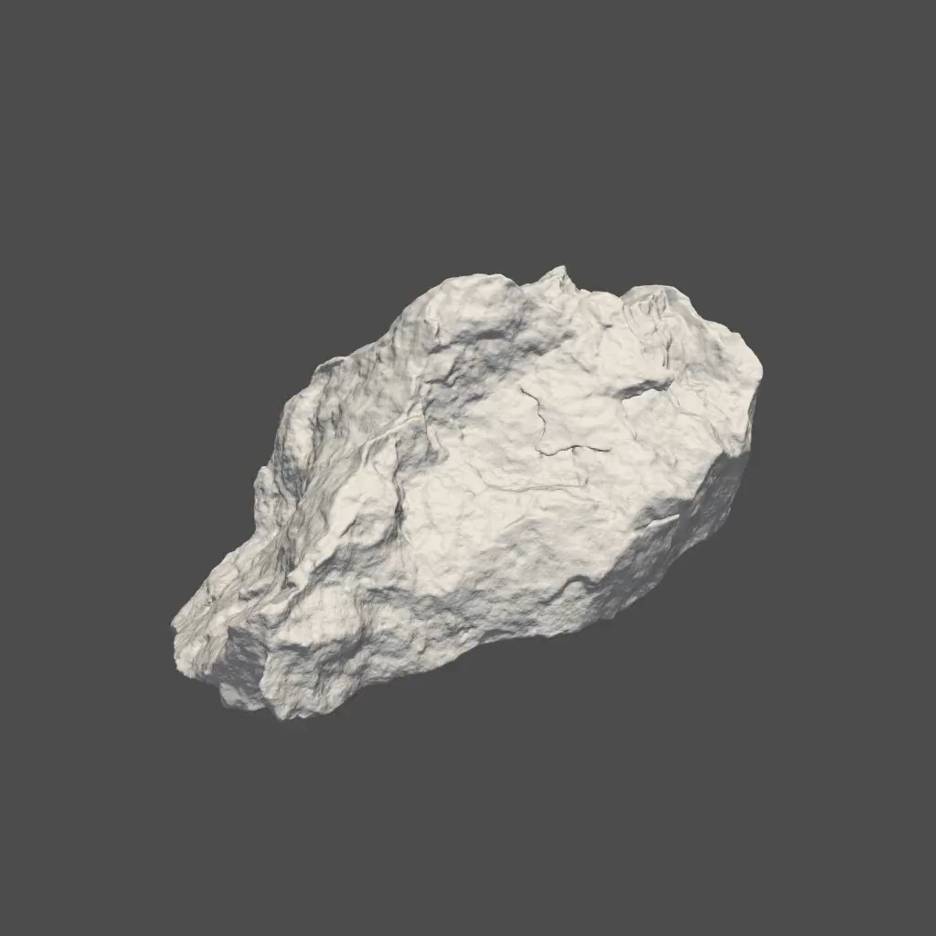
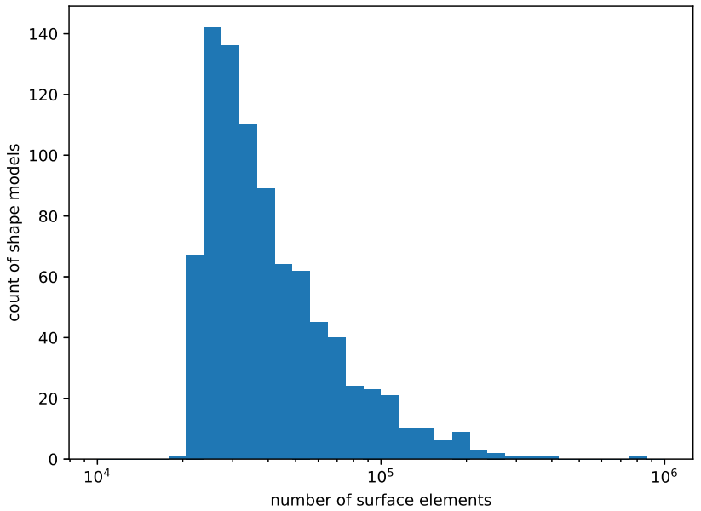
The database
https://shapemodels.asu.cas.cz
868 shape models
Wavefront OBJ format
principal axis coord. system
~ 20 000 – 760 000 surf. fac.

Slide 20
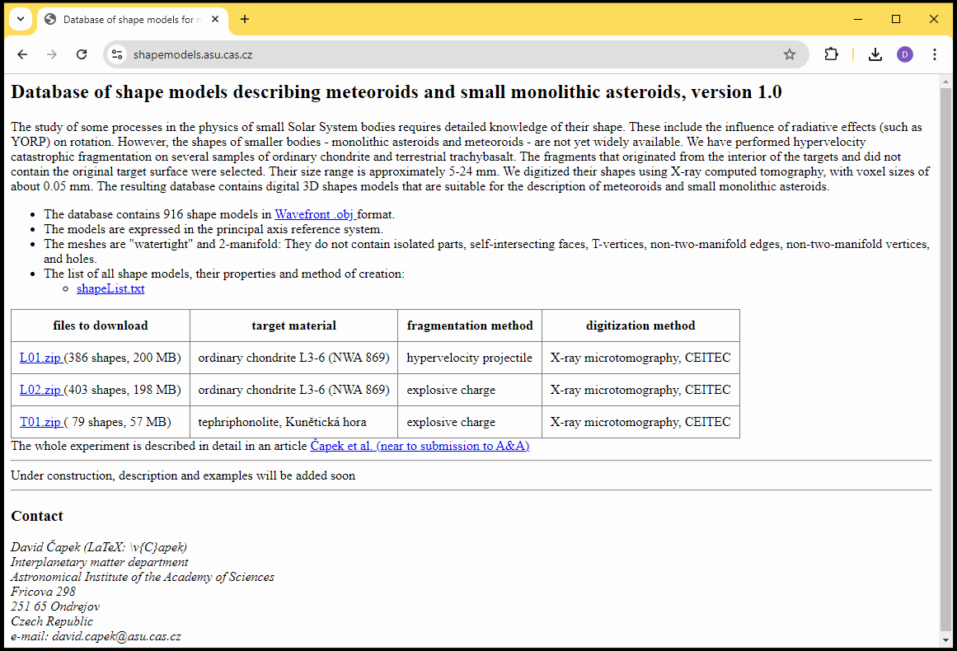
The database

Slide 21
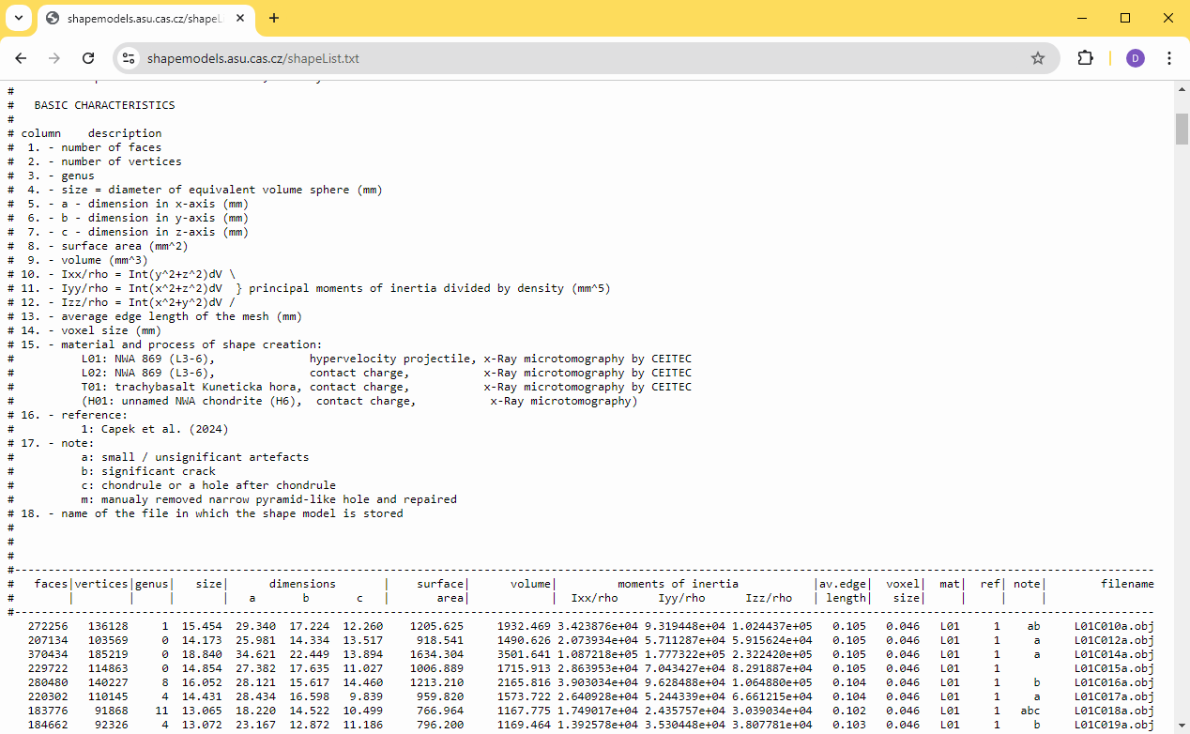
The database

Slide 22
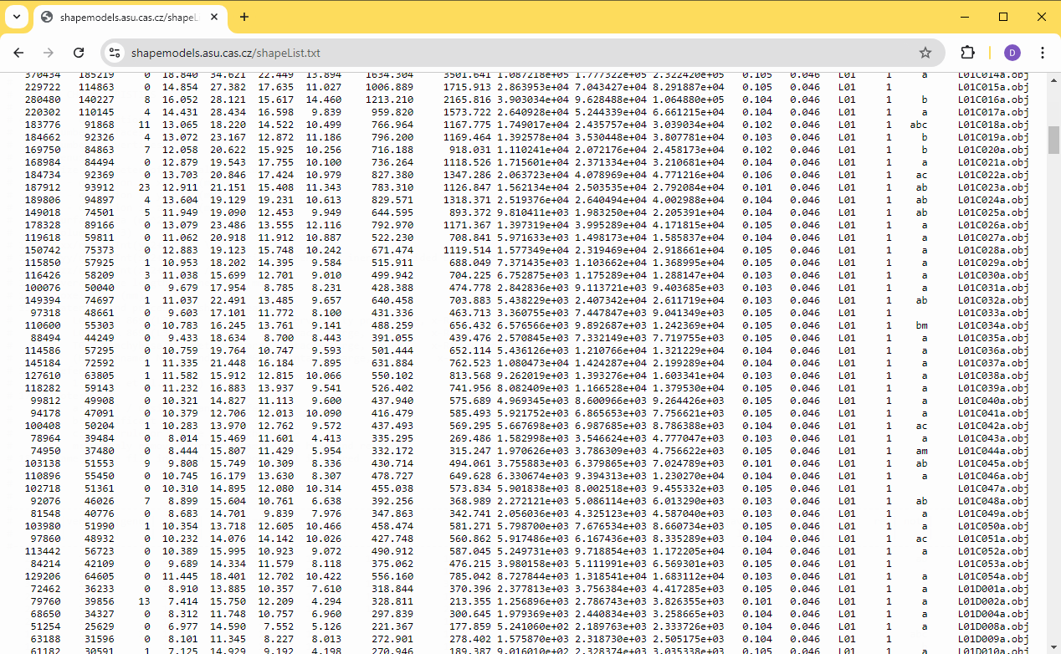
The database

Slide 23
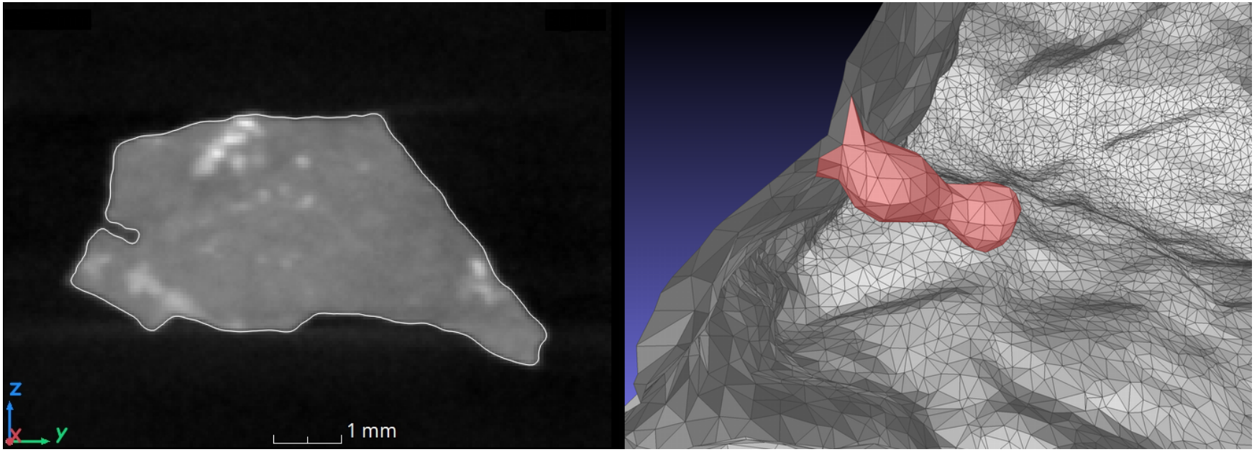
Surface features – minor artefacts (note a)
Surface features that cannot be expexted on real bodies in space (weathering proceses, digitization dificulties,…)
Affects only negligible part of the surface
383 cases

Slide 24
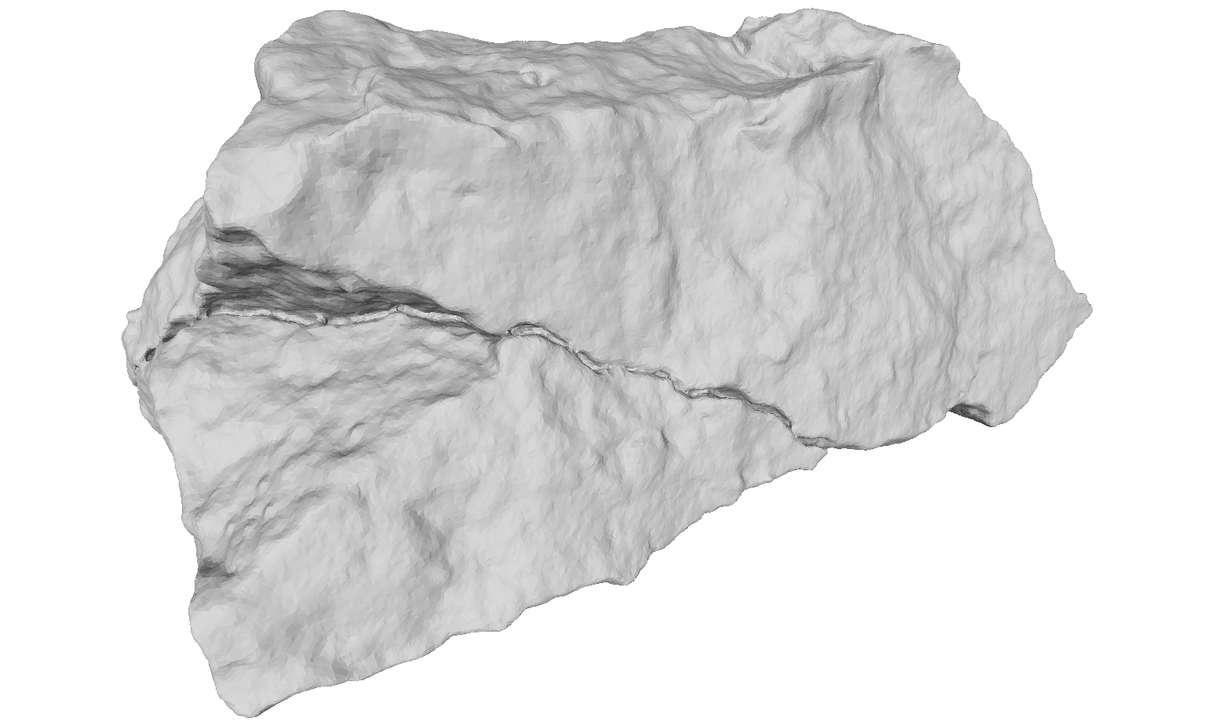
Surface features – fractures (note b)
101 cases

Slide 25
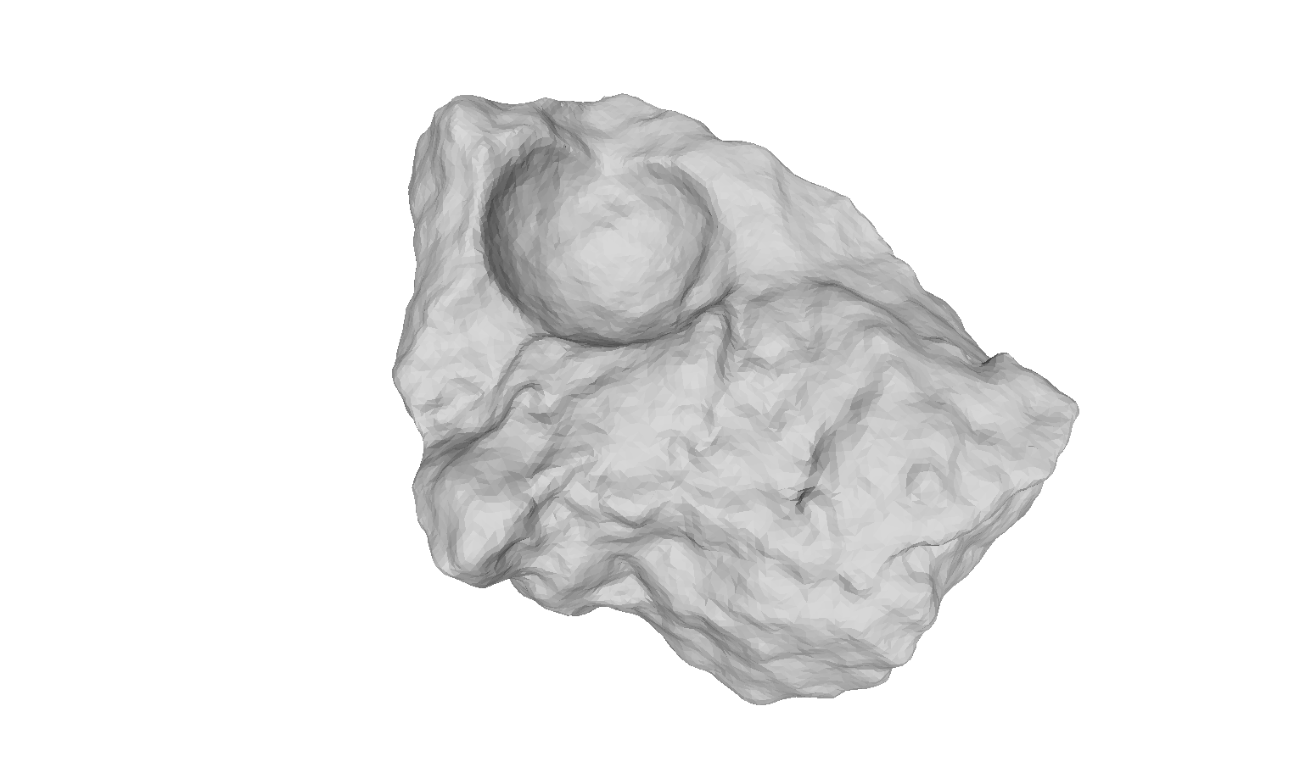
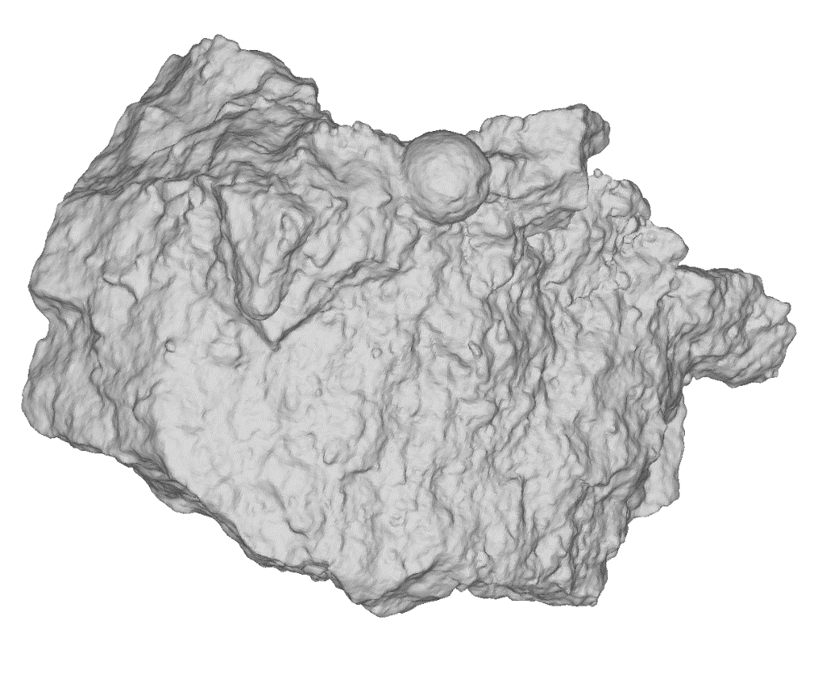
Surface features – chondrules (note c)
24 cases

Slide 26
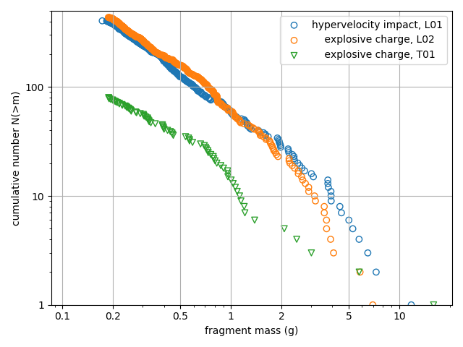

Fragments size distribution
L01, L02: $N\left(>m\right)∝m^{−1.06}$
T01: $N\left(>m\right)∝m^{−0.84}$
Both fragmentation methods → the same size distribution
T01 – lower specific energy

Slide 27
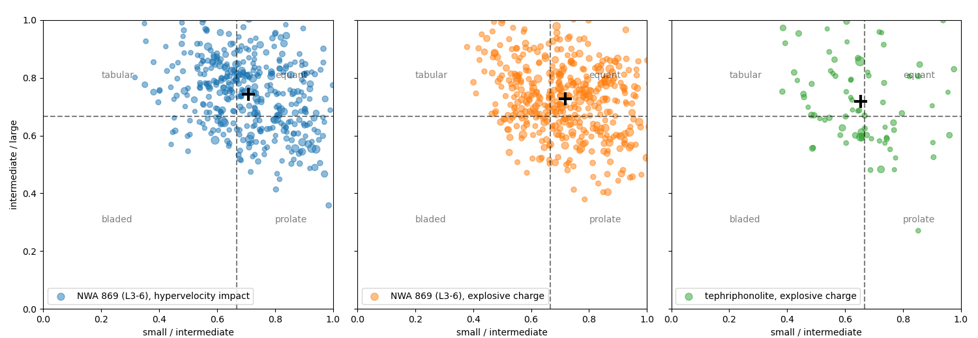
Fragments shape distribution
target | c/a | c/b | b/a
L01 | 0.52±0.12 | 0.71±0.15 | 0.74±0.13
L02 | 0.52±0.12 | 0.72±0.15 | 0.73±0.13
T01 | 0.46±0.13 | 0.65±0.14 | 0.72±0.15

Slide 28
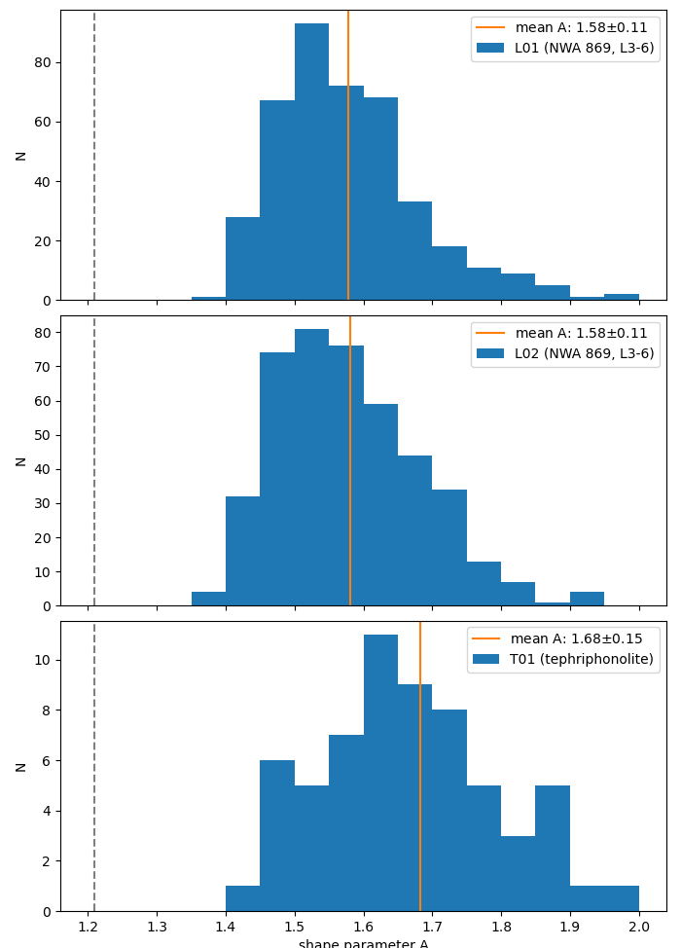
Shape factor A = 1.6
Solar radiation pressure
Motion in atmosphere
mean silhouette area
volume

Slide 29
Future work
Rotation of meteoroids in space
Database expansion
  Manually removed artefacts
  The same fragments digitized by another device
  Low velocity fragmentation
  …
Acknowledgement
Grant Agency of Czech Republic grant no. 20-10907S
Project RVO:67985815

